Slide 1
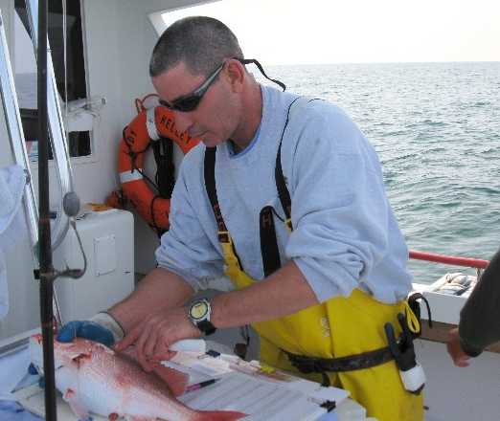
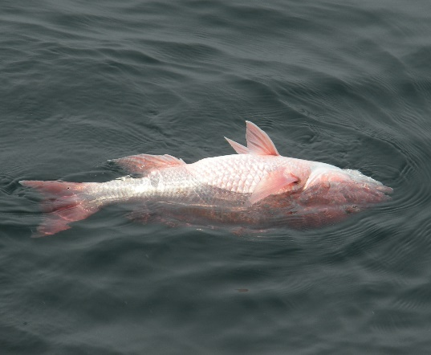
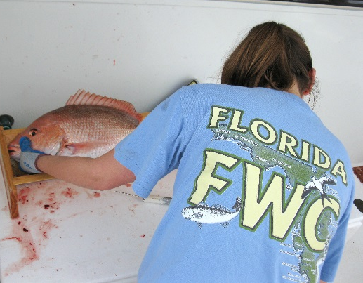
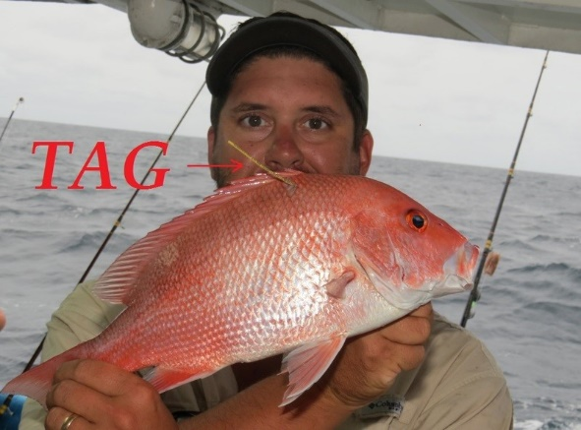
Monitoring Recreational Discarding of Reef Fishes off the Atlantic and Gulf of Mexico Coasts of Florida
Beverly Sauls
Florida Fish and Wildlife Conservation Commission
Fish and Wildlife Research Institute

Slide 2
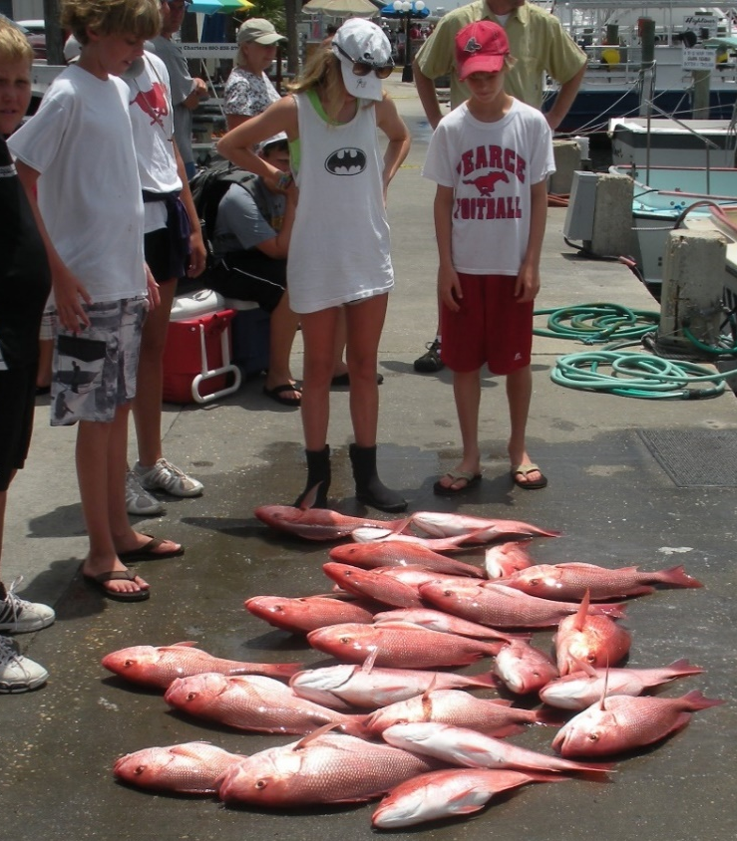
Data Collection for Discards
Trip level details
  Number discarded
  Immediate mortality
  Area fished
  Capture/release methods
Easily collected dockside
Does not provide characteristics of discards needed for assessments

Slide 3
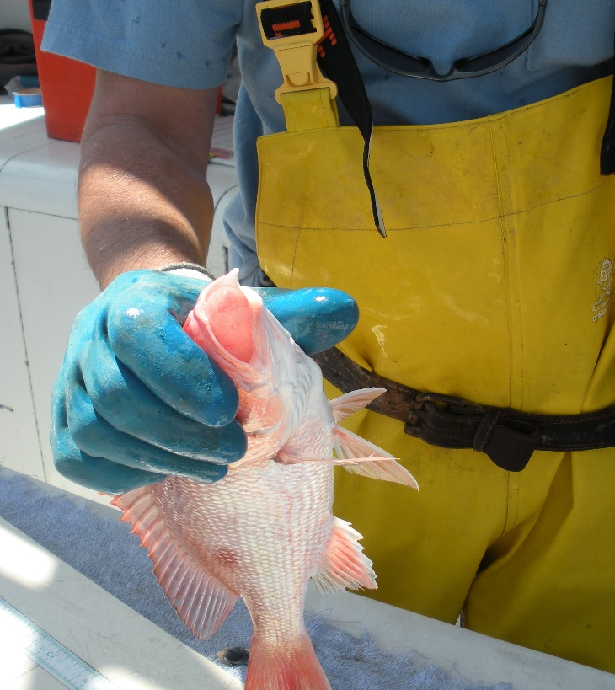
Data Collection for Discards
Fish Level Details
  Length
  Capture depth
  Capture/release method
  Release condition
Insights for assessments:
  Future harvest
    size distribution of discards
  Selectivity
    circle hooks, size at depth fished
  Discard mortality rate
  Size (age) of discard mortalities
Notes:
May not be collected dockside!!!

Slide 4
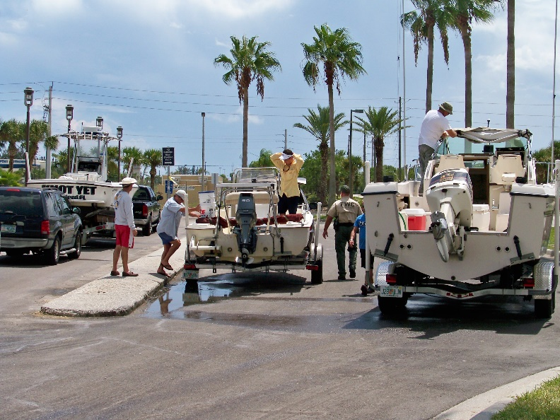
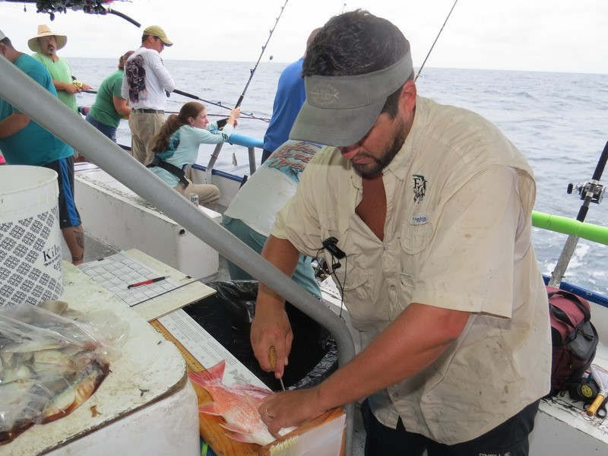
Methods in Florida
Dockside surveys
  trip level details from private boat fishery
At-sea surveys
  trip level and fish level details from for-hire fishery
  May be used to make inferences about private boat discards

Slide 5
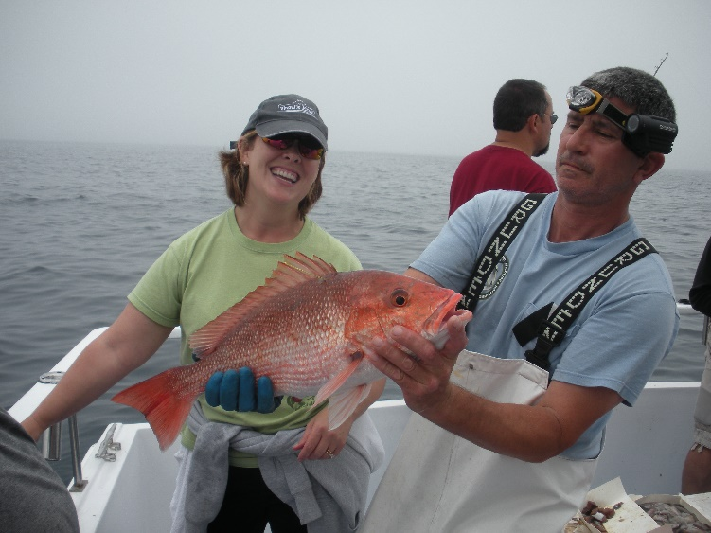

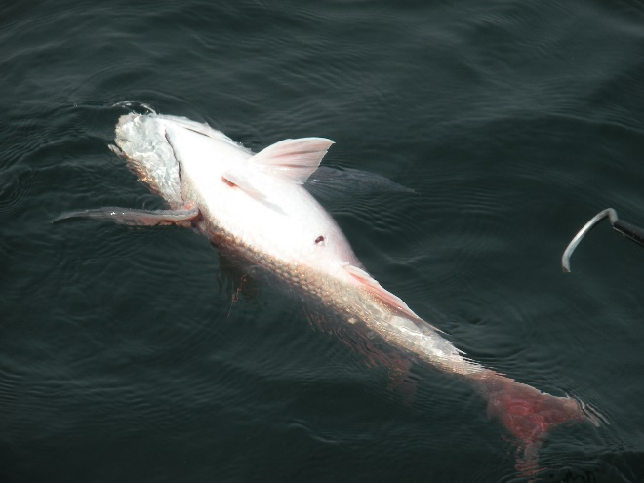
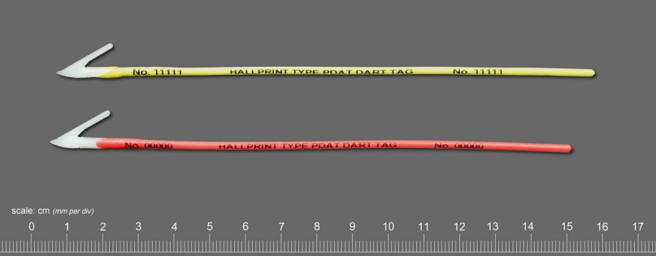
At-Sea Surveys
Directly observe fish as they are caught
Record:
  Size
  Area fished
  Injuries/Trauma
  Venting/Hook-type
  Release condition
Mark discards
with conventional tags
  estimate discard M
www.hallprint.com

Slide 6
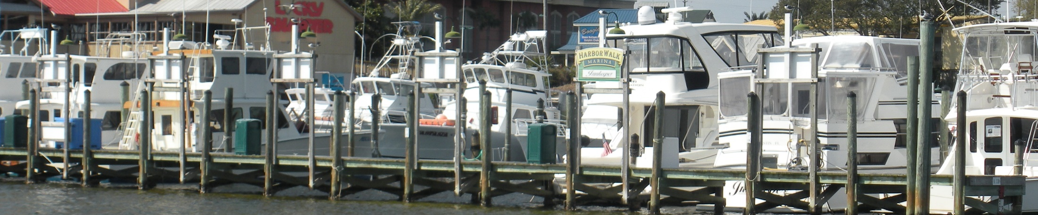
Vessel Selection
List of cooperative vessels
Randomly select vessels each week by:
  region
  vessel type (charter, headboat, multi-day)
Observers go out with first drawn vessel with an available trip during the week sampled
  Regardless of trip type

Slide 7
Sample Weighting
Proportional fishing effort used to weight samples collected from each trip-type post-hoc.
  Headboat logbook trip reports
  For-Hire Telephone Survey
W_{a}= (N_{a}/N) / (n_{a}/n)
Where:
N_{a} = total effort for trip-type a
N = total effort
n_{a} = sample effort for trip-type a _{and}
n = total sample effort

Slide 8
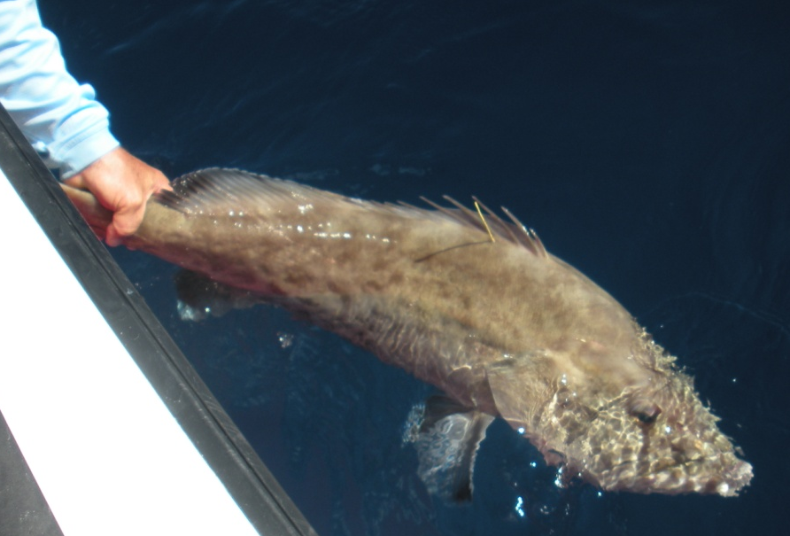
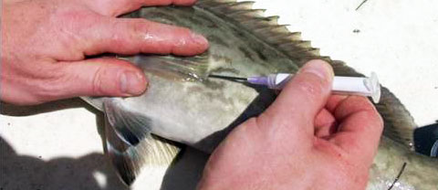
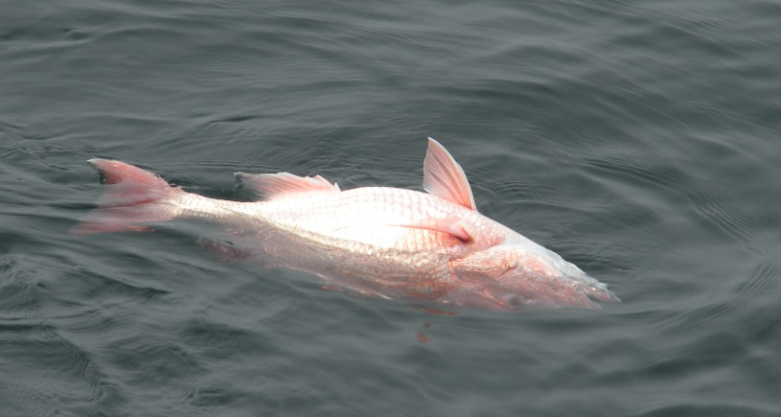
Release Condition
Unvented
  Not impaired at surface
  No hook or gill injuries
Vented
  Not impaired at surface
  No hook or gill injuries
Impaired
  Disoriented or floating at surface (regardless of venting)
  Suffered hook and/or gill injuries
Notes:
Important not to include vented fish in Good category because:
Vented fish tended to suffer more barotrauma
Confounded with the submergence measure because the fish may have only submerged because it was vented.
Venting also increases handling time, increases potential for internal injury.

Slide 9
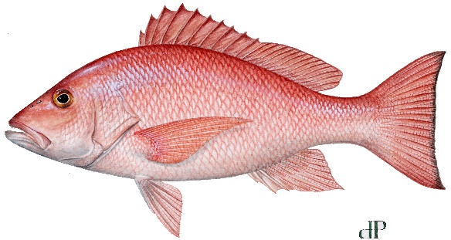
Relative Survival
Methods (for gag): Sauls, 2014. Fisheries Research 150: 18-27
Notes:
Control variables: latitude, year, month, length (Gulf only)

Slide 10
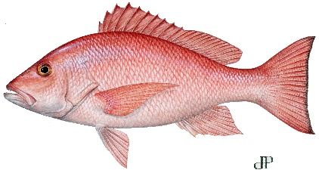
Estimated Mortality
Notes:
Not feasible to place observers on private boats.
Could collect basic data on depths fish and apply to this type of model to estimate % mortality.

Slide 11

Hook Comparisons
Notes:
Helps make inferences back in time before circle hooks were required.

Slide 12

South Atlantic
Notes:
Length Frequency
Input in stock assessments
Recruitment signals, used to forecast
May facilitate more responsive management

Slide 13
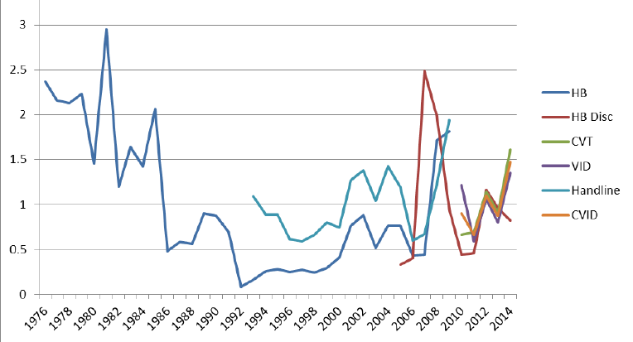
S. Atlantic Abundance Indices
Source: SEDAR 41

Slide 14
Private Boat Fishery
Gulf Reef Fish Survey (GRFS)
  Gulf coast
  Review for MRIP certification in progress
Supplemental dockside biological sampling project
  Atlantic coast
  MARFIN project, funded 3 years

Slide 15
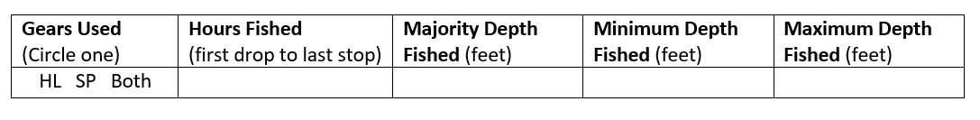
Gulf Reef Fish Survey
Intercept survey
Depths fished
  Useful for evaluating discard mortality

Slide 16
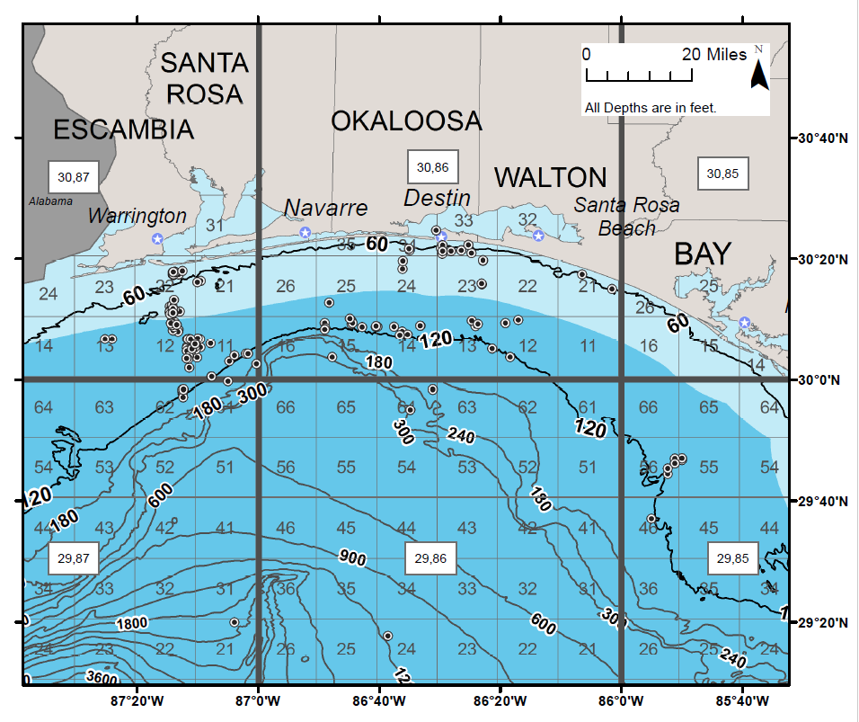
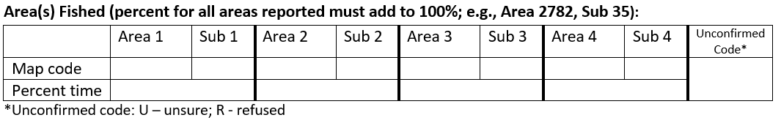
Area(s) fished:
10 mile grid

Slide 17
MARFIN
Dockside survey
  Randomly sample landing sites for offshore trips
Primary objective:
  Lengths, weights, age structures from harvested fish
Secondary objective:
  Trip-level area fished (for harvest and discards)
 | Majority of time | Minimum | Maximum
Depths fished (feet)
Distance from shore (miles)

Slide 18
Conclusions
At-Sea Observer Surveys:
provide high resolution fish level data for stock assessments
may provide insight into private boat fishery if trip level details are known
Dockside Surveys:
Good for collecting complementary trip level data
Supplemental surveys can provide data not collected through APAIS

Slide 19
Thank you!

Slide 21

Gulf
Atlantic
Notes:
Figure x. Percentages of large (>507mm TL), medium (404-507mm TL), and small (<404) Red Snapper discards observed from shallow (<30 meters) and deep (>29 meters) fishing depths during recreational fishing trips on for-hire charter boats and headboats taken in the Gulf of Mexico (WFL) and Atlantic (EFL) by release condition category. Controlling for the effects of region and depth, there was a positive linear association between increased length and severity of impairment (Cochran-Mantel-Haenszel Statistic = 448.9, p <0.0001).

Slide 22
Hook Types

Slide 23



FL For-Hire Observer Programs
 | 2005-2007 | 2008 | 2009 | 2010 | 2011 | 2012 | 2013 | 2014 | 2015 | 2016 | 2017 | 2018 | 2019
GULF
Charter |  |  | X | X | X | X |  | X | X | X | X | X | ?
Headboat | X |  | X | X | X | X | X | X | X | X | X | X | ?
KEYS
Charter |  |  |  | X | X | X |  | X | X | X | X | X | ?
Headboat | X |  |  | X | X | X |  |  | X | X | X | X | ?
ATLANTIC
Charter |  |  |  |  |  |  | X | X | X
Headboat | X | X | X | X | X | X | X | X | X | X | X | ? | ?
Notes:
Simplify this figure…

Slide 24
Mark-Recapture Study Design
1
.
.
.
.
n
2009 2010 2011 2012
Fates unknown
Survivors
Notes:
Fish were tagged year-round, over multiple years, and over a large geographic area.
Therefore, it was necessary to control for potential covariates on recapture rates for fish tagged in different regions, different years, and different times of year.
Each line in this figure represents an individual fish that was tagged during a catch-and-release event in the fishery.
Blue shaded areas represent periods of time when the recreational harvest season for gag was open, and the white areas represent when harvest was not allowed.
Notice that each was exposed to different levels of targeted fishing effort over varied amounts of time.
Needed an individual-based model to control for potential factors that varied among each fish in the study.
The first 3 fish in this figure were not reported as recaptured at the time the study ended.
For these fish, their true fate is unknown. They could have survived or they could have suffered mortality.
The next three fish were at-large for varied amounts of time before they were reported as recaptured for the first time. For these fish we know both the amount of time they were at-large, and that they survived the initial catch and release event.

Slide 25
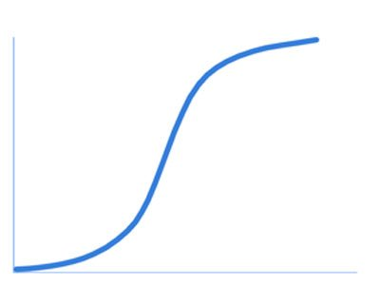
Proportional Hazards Regression
F(t) = pr (T<t)
h(t|x) = h₀(t) * exp(βx)
Probability of recapture
or censoring as function
of time
Covariates, control for variable recapture rates among individual fish
Compare recapture rates among condition groups to estimate relative survival
t = time
Fisheries Research (2014) 150: 18-27
Notes:
This model estimates the probability that each tagged fish is recaptured as a function of the amount of time it has been at-large.
Fish that have only been at-large for a short period of time have not been exposed to a lot of search time in the fishery and their probability for recapture is initially low. The longer fish are exposed to fishing pressure, the more likely they are to be found, and the probability begins to increase.
If it can be assumed that losses due to tag shedding, non-reporting, and migration affect all individuals the same, regardless of which release condition group they belong to, then you can compare the cumulative distribution functions among those groups to test whether any group experiences reduced tag return rates due to increased mortality.
Consider this simple model with just one x variable that describes whether a fish is released in good or poor condition.

Slide 26
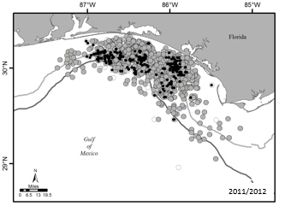
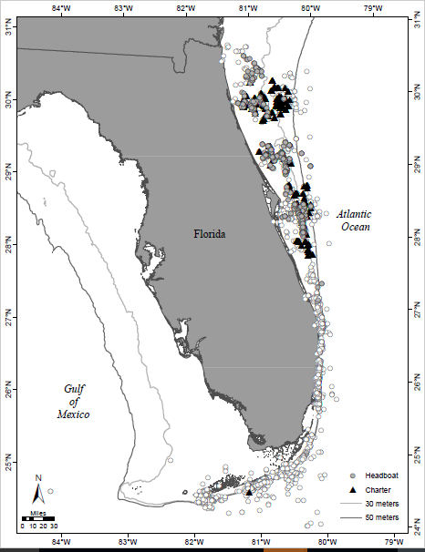
Panhandle (Gulf)
Gray = charter
Black = headboat

Slide 27

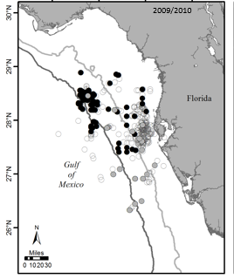
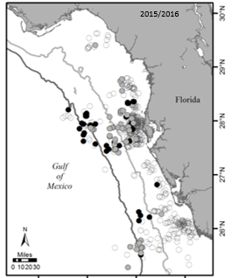
2009-2010
2015-2016
Gray = charter
Black = headboat
Notes:
Early years, RS discarding primarily observed from multi-day trips.
Later years, RS more abundant nearshore, observed in more single-day trips.
Helps us to understand trends in discards for PR as well as for-hire as RS rebuild in E. Gulf

Slide 28
2005-2016
Keys

